Slide 1
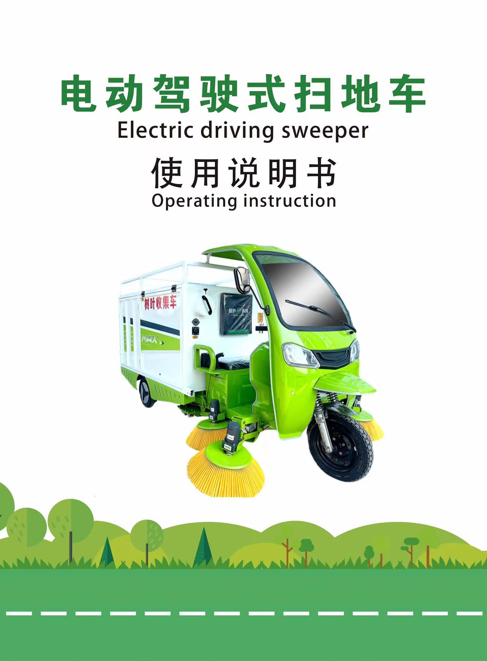

Slide 2
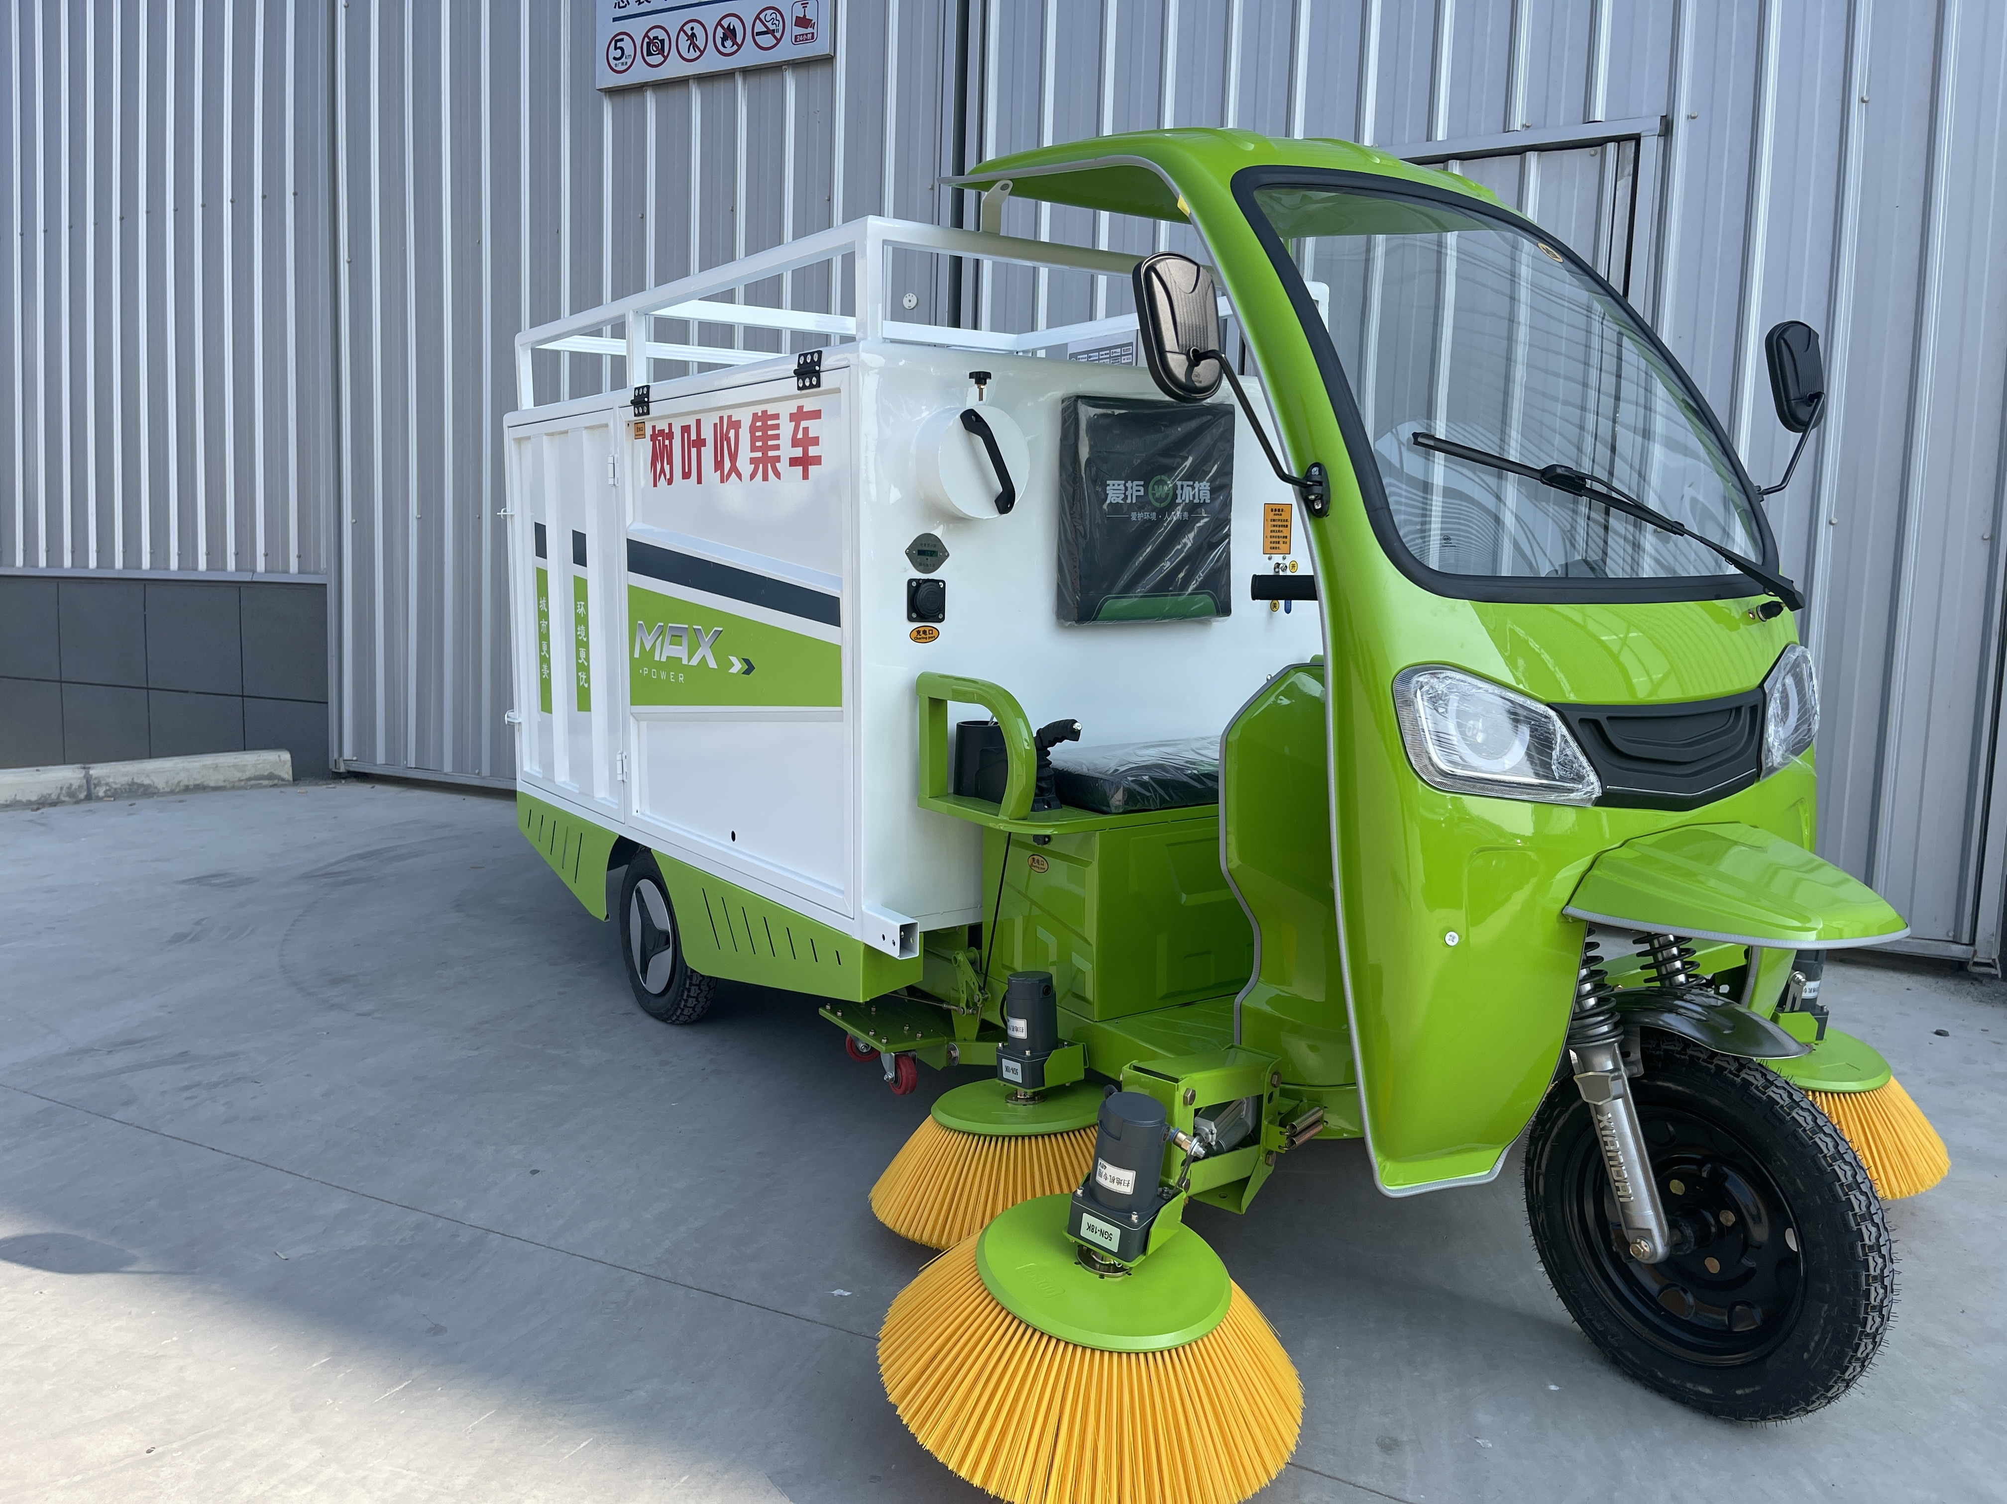
Welcome to use the electric ride-on leaf collection truck, the company specializes in the production of electric ride-on sweepers, the equipment introduces foreign advanced technology. It integrates suction and sweeping, and has a strong cleaning ability, no pollution and no noise. Easy to operate, long continuous operation time, easy to maintain, absolutely value-for-money, can be applied to, landscaping, streets and alleys, factory workshops, property communities, campus squares, etc.

Slide 3
Table of Contents
1. Fuselage appearance ............................. 1 II. Technical Parameters ........................... 2 3. Operating instructions 1. Panel control .................................. 3 2. Walking throttle and brake ..................... 4 3. Disassembly and installation of garbage cans ... 5 Fourth, daily maintenance and dismantling and replacement of wearing parts 1. Side brush height adjustment ................... 6 2. Replacement method of side brush ............... 7 V. Precautions ..................................... 8 VI. Common Phenomena and Treatment Methods ......... 9

Slide 4
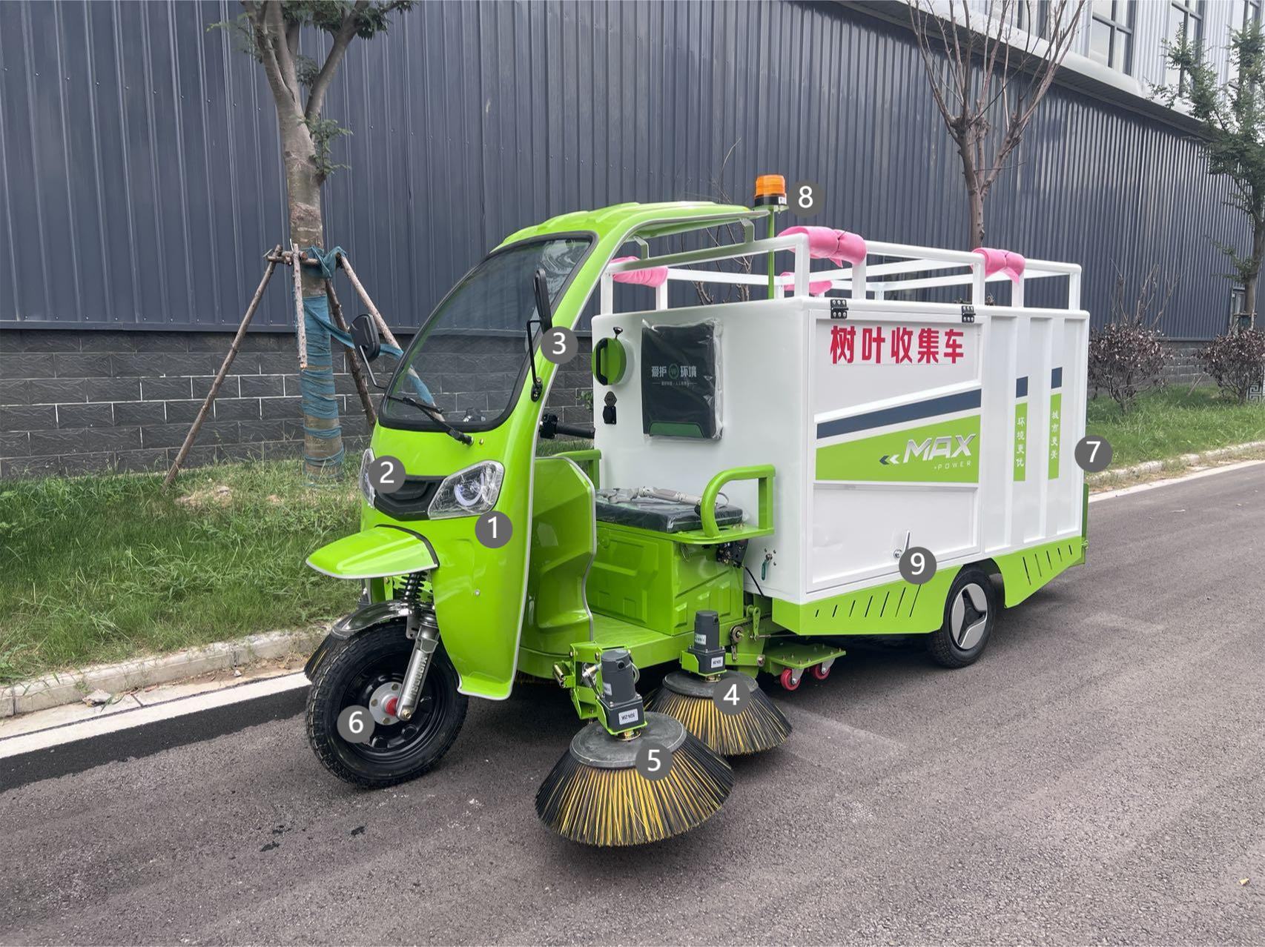
一、Fuselage appearance
(1) (2) Lighting (3) Rearview mirror (4) Side brush (5) side brushes (6) tires (7) garbage bins (8) Warning light (9) Door lock

Slide 5
Technical parameters
serial number | project | Parameter value/specification
1 | Product model | Efficient leaf collection cart four brushes and one suck money
2 | Dimensions | 4000mm*2000mm*1860mm
3 | arrangement | Electric
4 | battery | 48-60V
5 | Travel motor | 1200W
6 | Walking speed | 20-42km/h
7 | Cruising range | 30-50km
8 | Receiver box | 0.6m³
9 | Sprinkler device | Dust removal spray
10 | Lifting mode | Intelligent one-click operation
11 | Suction pipe diameter | 200mm
12 | Sweeping width | 2000mm
13 | Water tank capacity | 80L
14 | craft | The whole car is electrophoretic painted

Slide 6
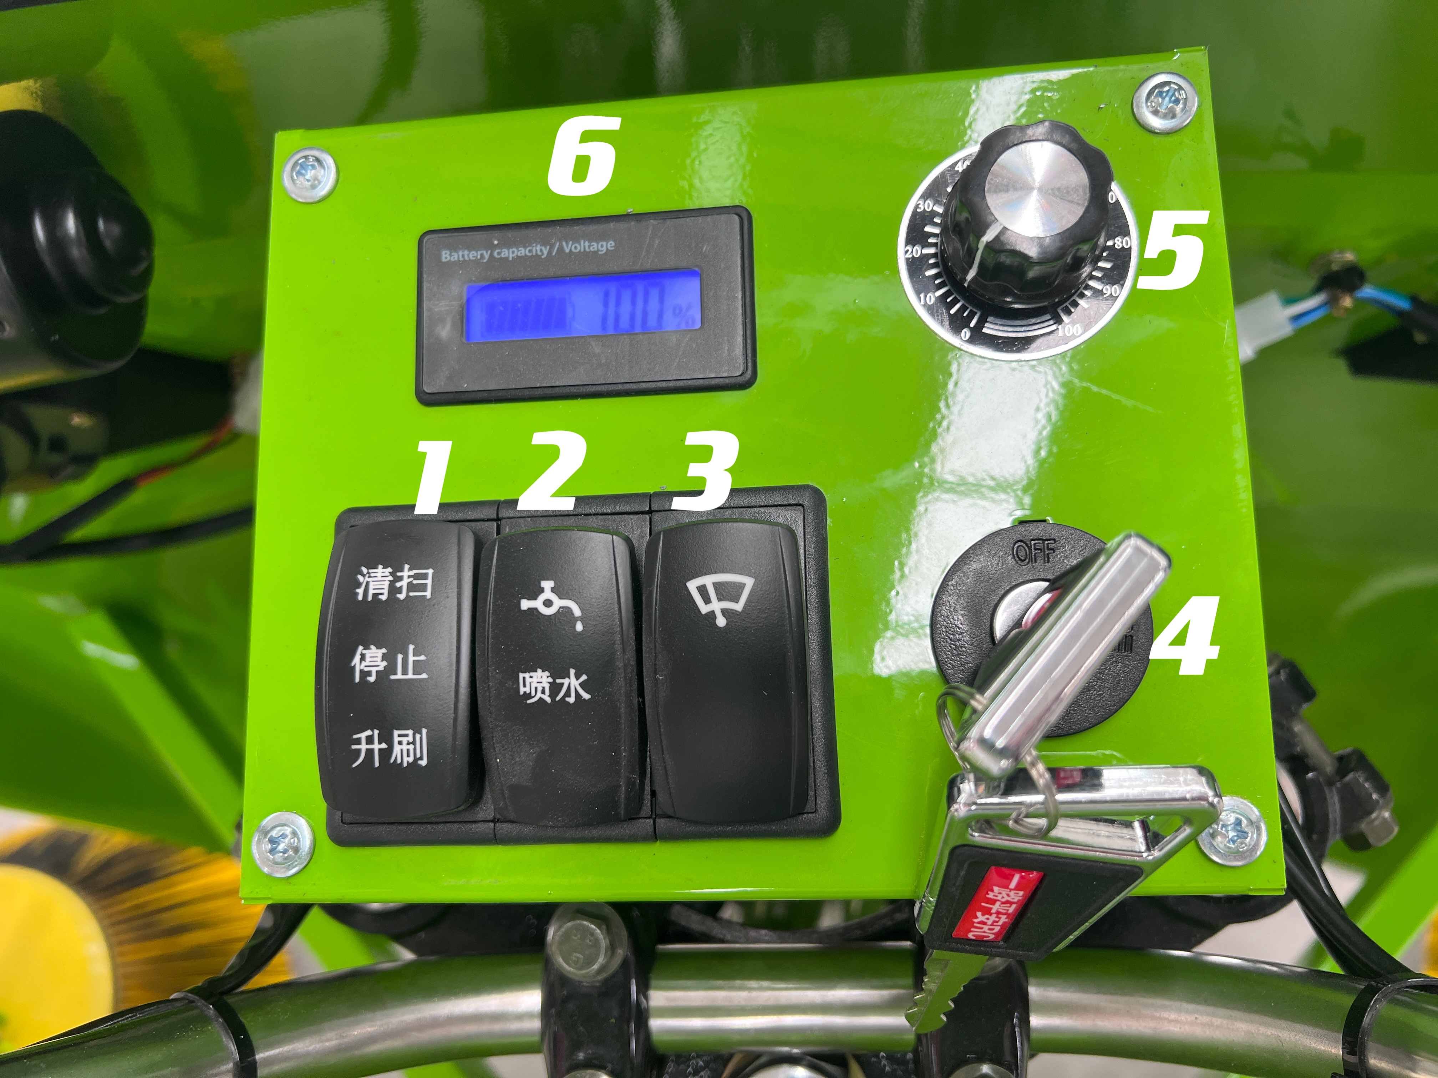
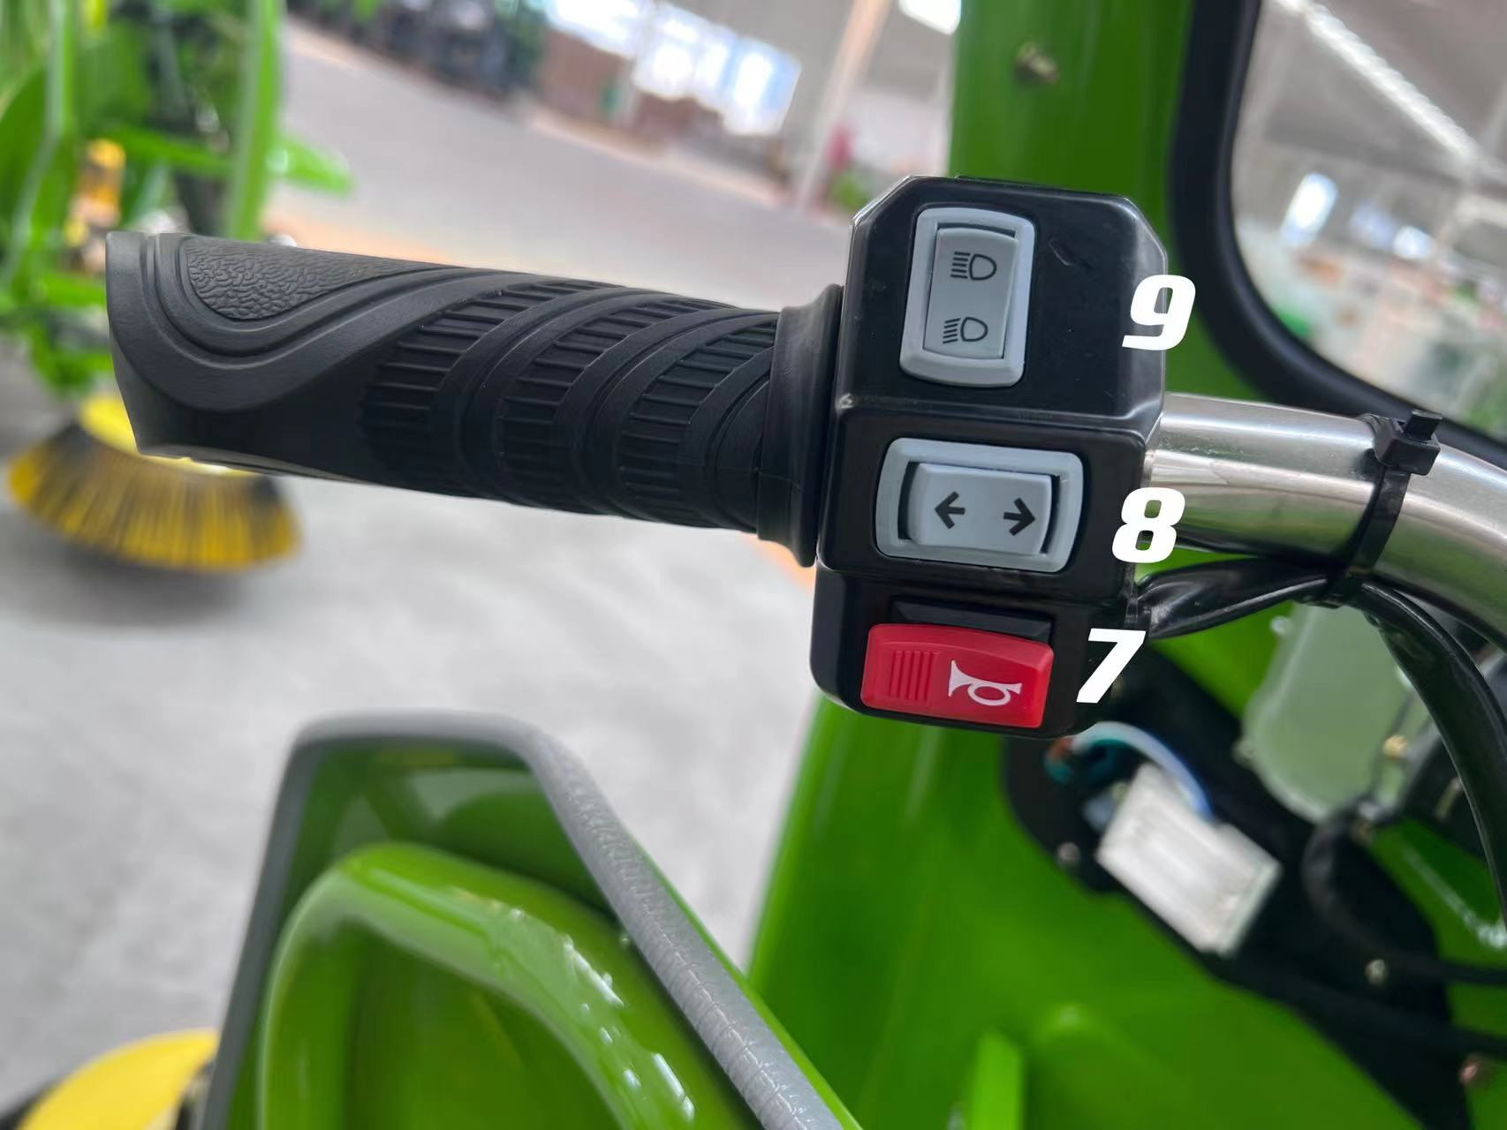
三、Instructions
1、Panel Control Instructions
1.Sweep, stop, and raise the brush 2.Squirt water 3.windscreen wiper 4、Power switch
5.Fan speed control switch 6.Battery level indicator 7.Horn switch 8. Turn signal switch
9.Headlight switch

Slide 7
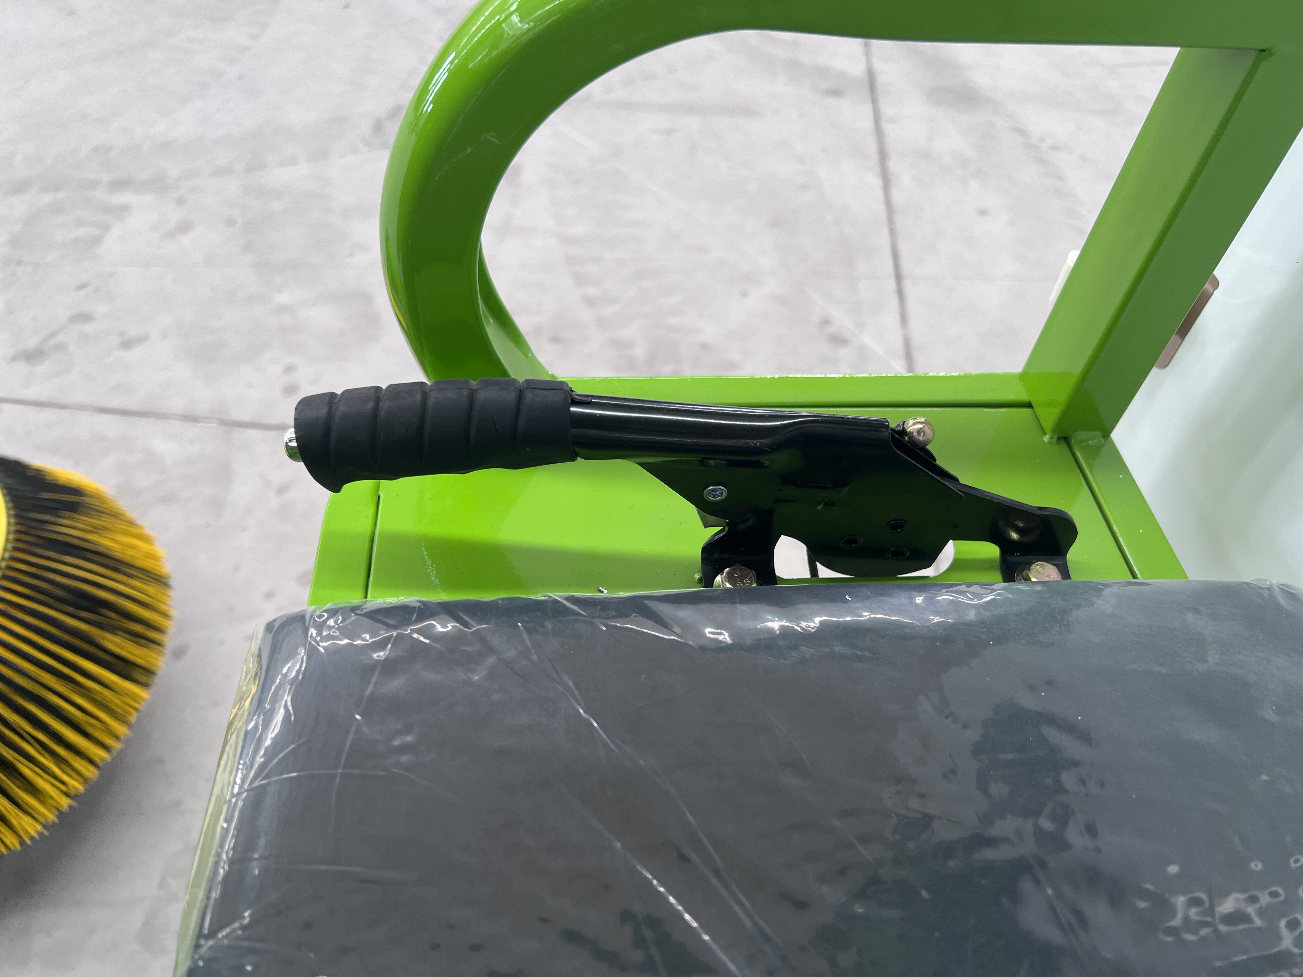
1
①Handbrake

Slide 8
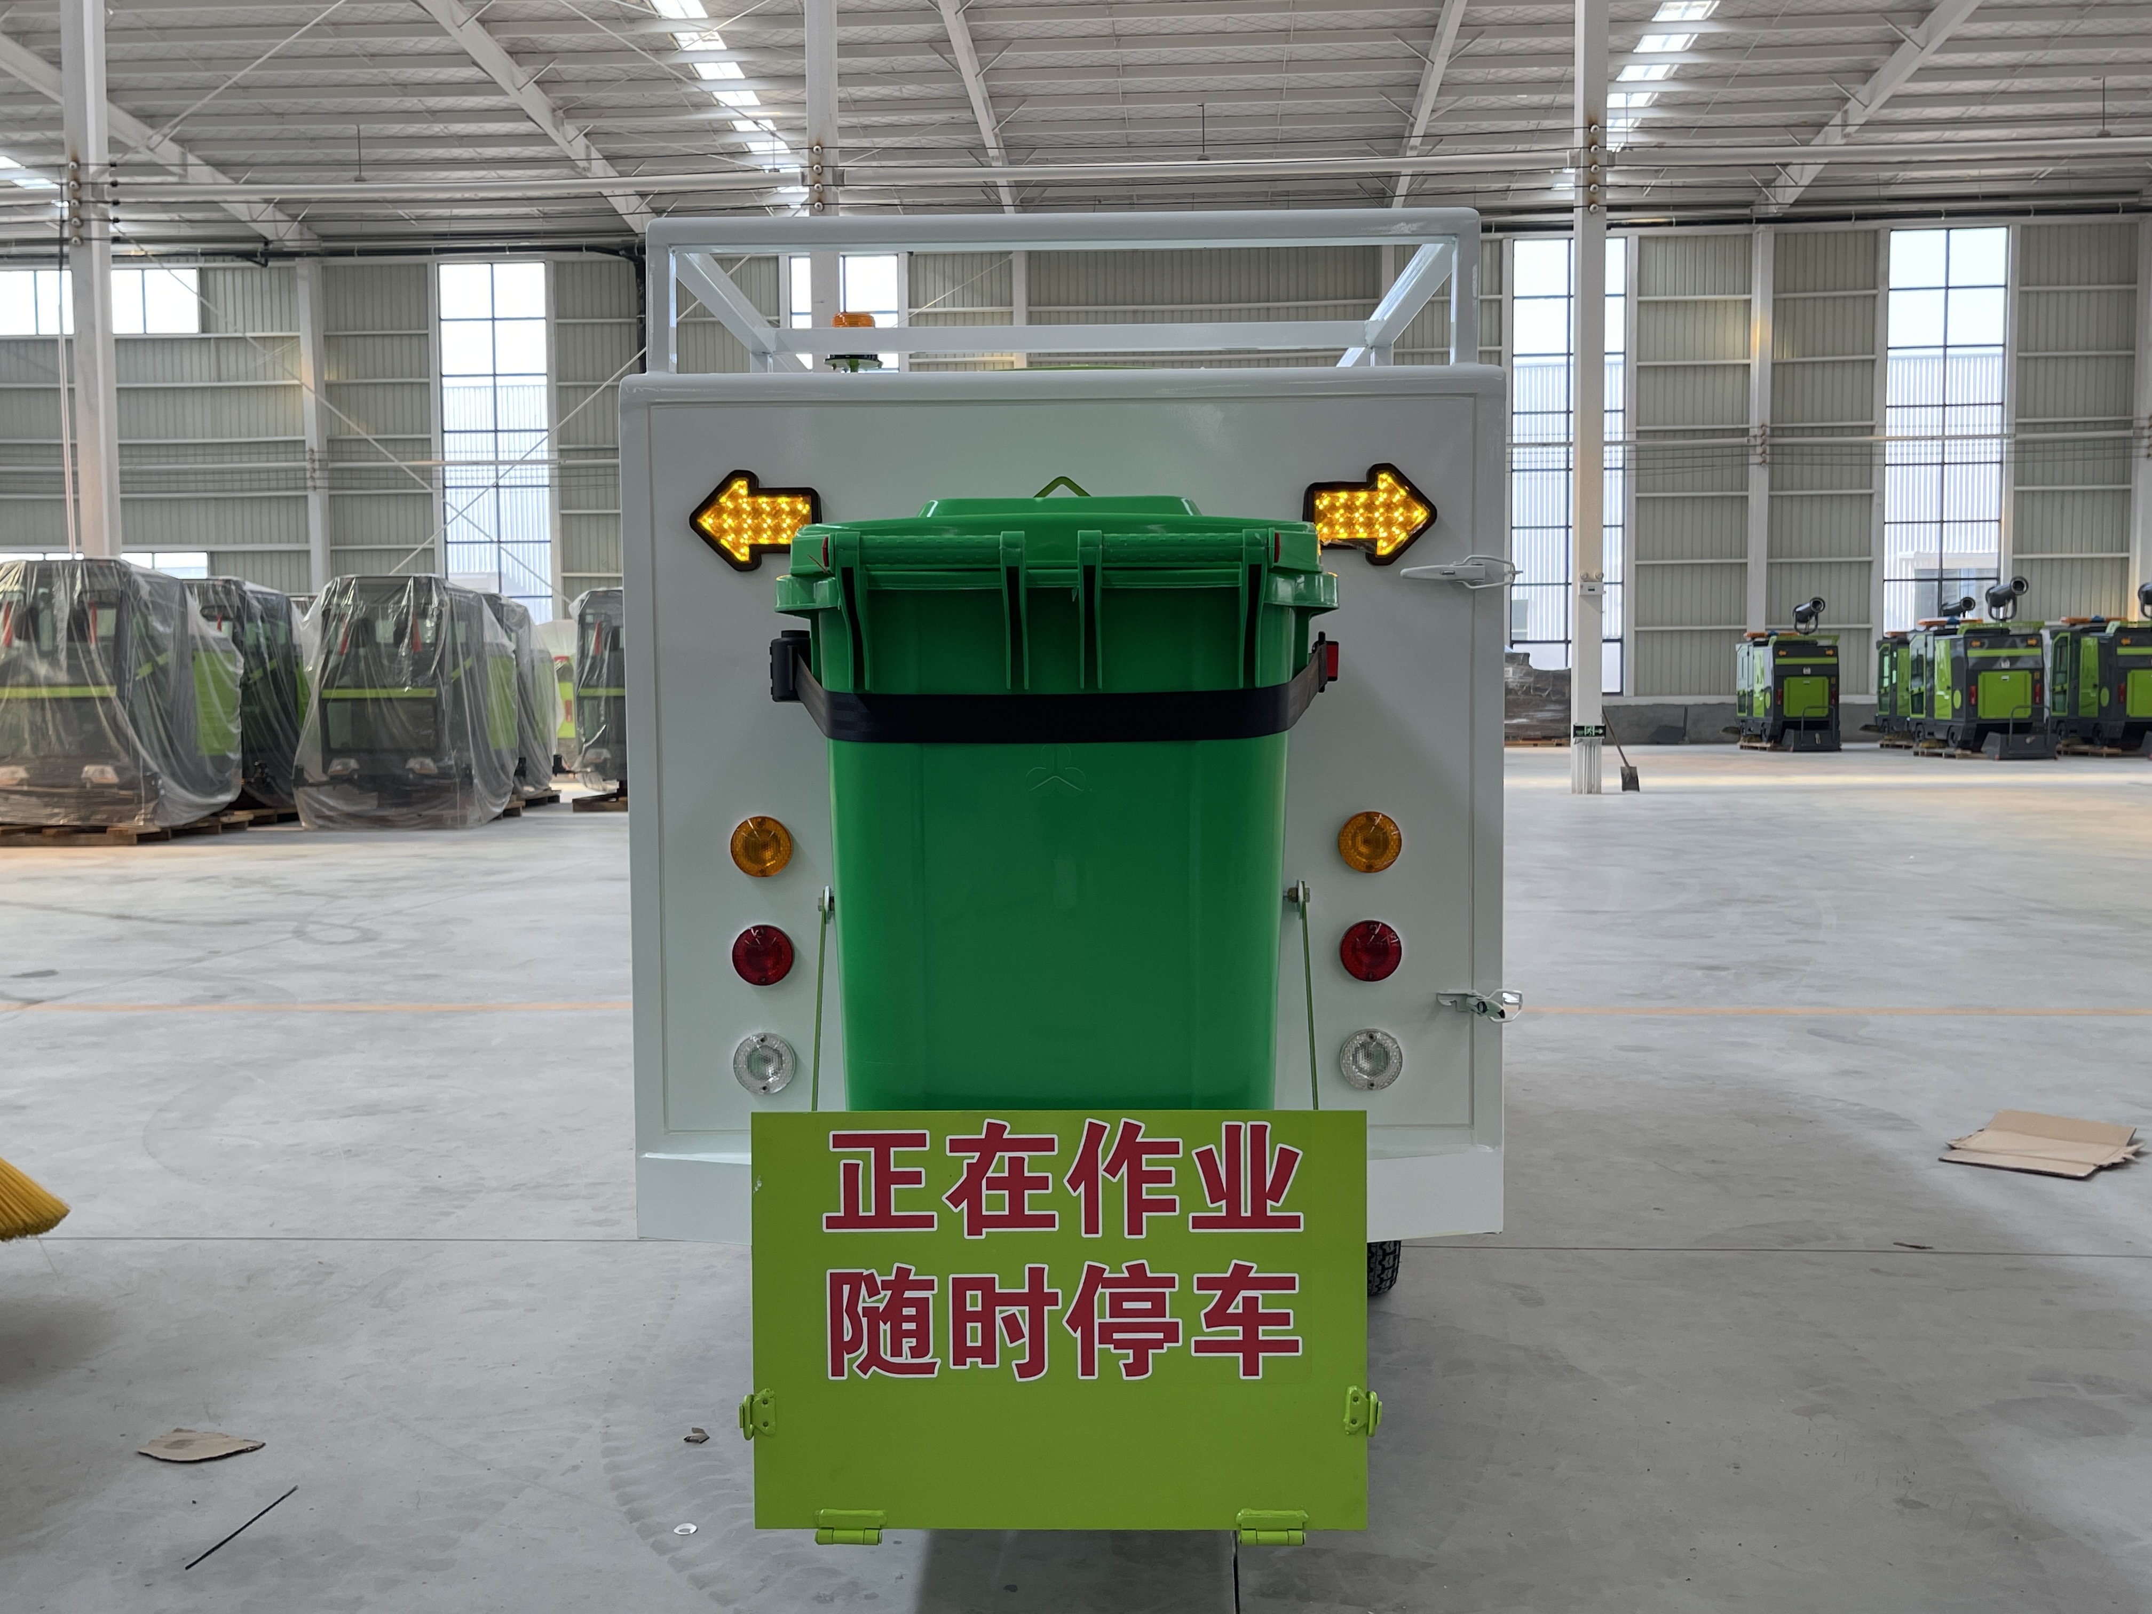
（3）Dismantling and installation of bins
①Hand clasp ②dustbin
If you need to dump garbage, first clasp the bin upwards ① Pull the bin apart and then pull the bin handle back to detach the bin from the sweeper.
After emptying the garbage, align the mouth of the garbage bin with the correct position of the sweeper, slowly push forward, push it to the end, and then press the hand buckle down to return the garbage bin to its place.
2
1

Slide 9
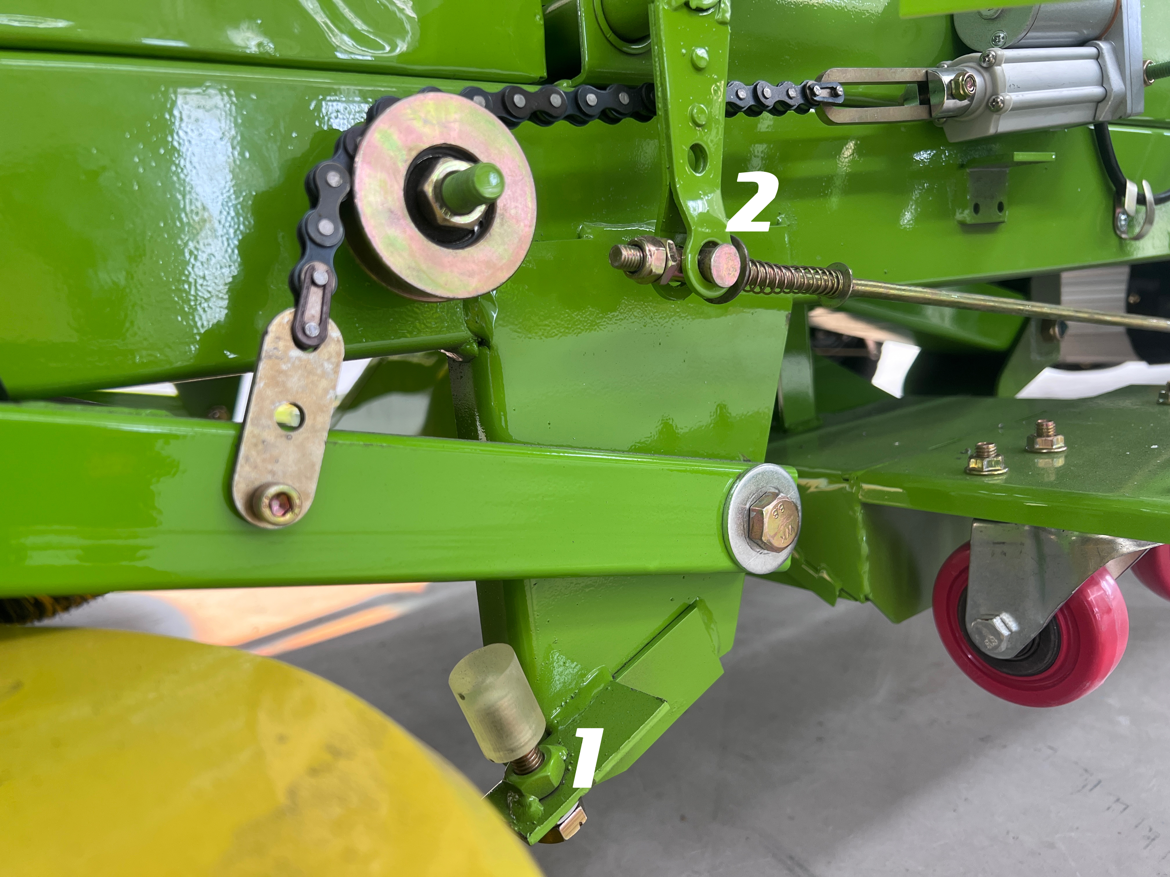
四、Routine maintenance and replacement of wearing parts
①Side brush height adjuster
②Brake adjuster

Slide 10
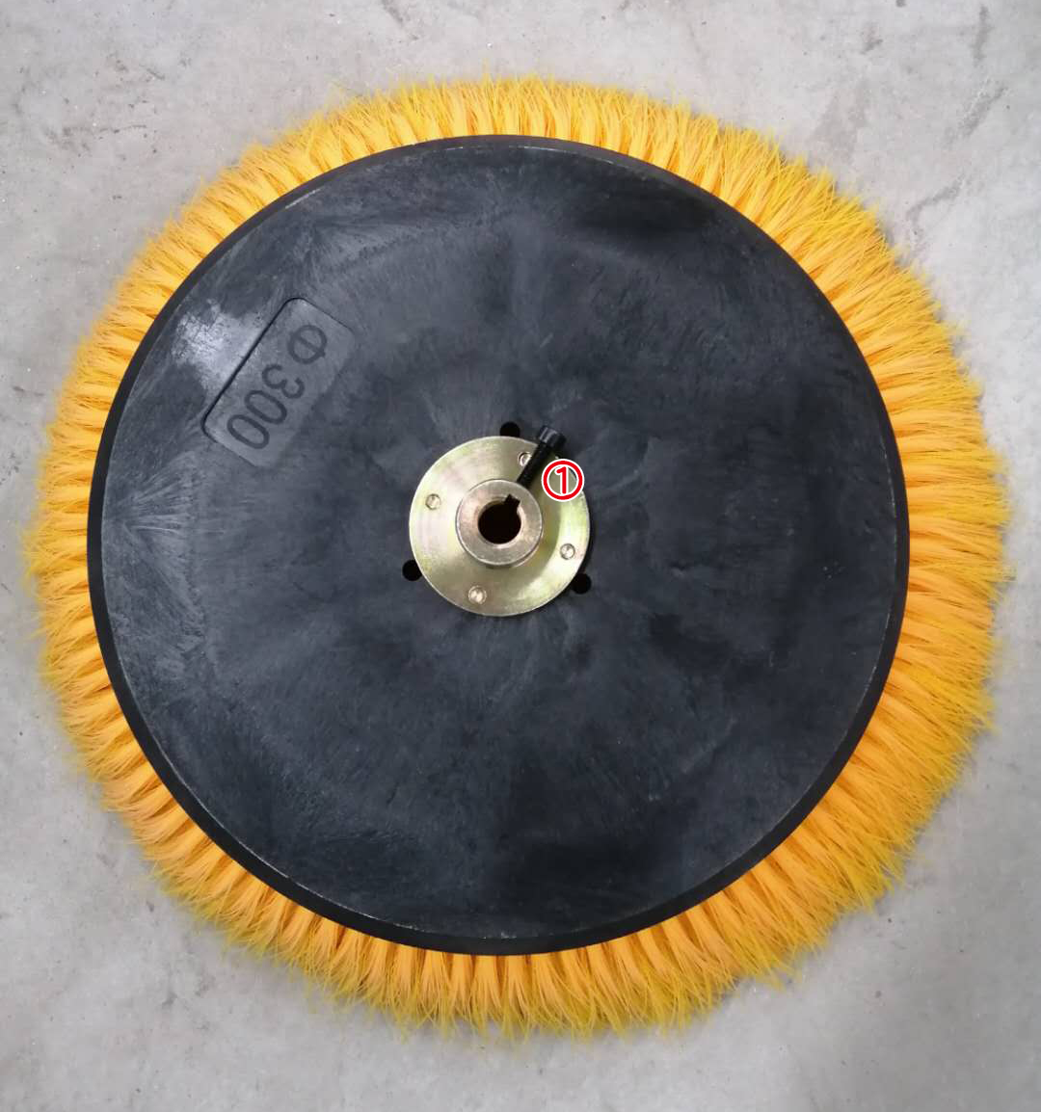
（2）Replacement of side brushes
When you need to change the side brush, first put down the side brush lifting lever and unscrew the fixed nut on the side brush
① The side brush can be removed and replaced.

Slide 11
五、Precautions
（1）Resolutely press the emergency stop power-off button when the person leaves (does not affect charging).
（2）It is strictly forbidden for non-professionals to operate this sweeper.
（3）It is strictly forbidden to suck and sweep silk and ribbon items.
（4）Deep discharge is strictly prohibited.
（5）It is strictly forbidden to park on a ramp.
（6）It is strictly forbidden to use it without power, please charge it in time.
（7）The sweeping environment is too wet, which affects the cleaning effect.

Slide 12
六、Common phenomena and how to deal with them
（1）Don't walk The associated parts are controllers, fuses, air switches, accelerators, drive wheels, batteries, corresponding terminal connectors and clues, any of which is damaged or in poor contact will cause not to walk, and the damaged parts can be restored by replacing the damaged parts.
（2）Do not sweep Each set of side brushes is driven by the corresponding drive motor to rotate to achieve the working effect. If one of the brushes does not work, it means that the drive motor is damaged and can be replaced. If the brushes of the whole vehicle are not working, check whether the relay fuse in the circuit board of the rear box is damaged, or whether the air switch is tripped, or whether the working button on the working panel is damaged。
（3）No sprinkling The main related components of the sprinkler function, such as water tank, water pump, water pipe, water valve, nozzle, relay, switch and control circuit. Common problems, by the leakage of the water tank, the rupture of the water pipe, the ligation is not strict, the faucet is blocked, the water pump is damaged, the electrical circuit failure, etc., if it is found that the joint is leaking, loosen the connecting section, and then wrap the raw tape and then fix it tightly.
（4）No lifting There are three lifts on the side brush of the whole vehicle, if one of the brushes does not lift, it means that the lifting rod motor of the brush is damaged, and it can be replaced. If the brush of the whole vehicle does not rise, check whether the control switch is damaged or whether the lower wire head of the control switch is loose or whether the relay in the electrical circuit board is damaged, and replace it.

Slide 13
（5）The cleaning is not clean Common reasons for poor cleaning are: 1. The cleaning speed is too fast 2. The side brush is too high or too low from the ground (2/3 of the normal height side brush touches the ground) 3. The suction cup is not falling If you encounter problems that cannot be solved, you can contact our company for after-sales, and we will provide you with a solution as soon as possible. Tips: This machine can sweep leaves, filaments and ribbons are not suitable for cleaning, and will be entangled in the fan.

Slide 14


